Slide 1
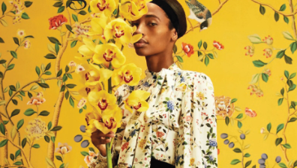
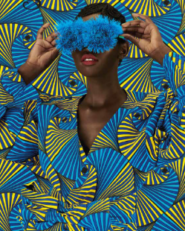
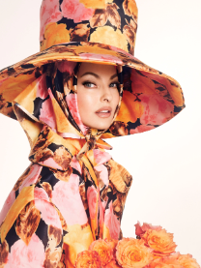
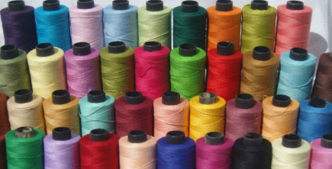
Alevel Textiles
Summer project 2023
AQA Art & Design: Textiles.

Slide 2
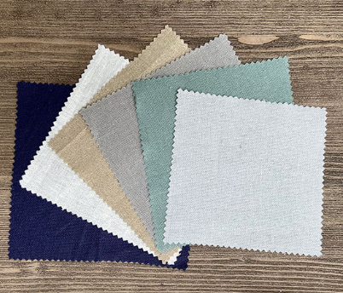
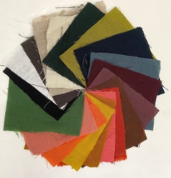
For your textile summer transition work I suggest you buy a sketch book or a pocket folder to record your work & thoughts. You can decide what size you use however I recommend A4 (landscape or portrait.)
Task 1: Different types of fabric and there uses.
The world is full of wonderful fabrics and they are all suitable for different uses. For this task collect between 10 – 20 small fabric swatches.
Present them in your book across two pages.
Cut your fabric samples to the same size.
Add a title: Different types of fabric and there uses.
Creative presentation is important think about how you present your text (font style/ typed of hand writtern)
Find out if the fabric is a natural fibre or man made. Also try and find out what the fabric is used for eg furniture upholstery, dressmaking, sport wear etc.

Slide 3
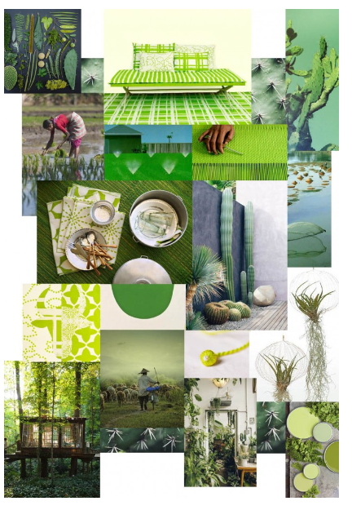
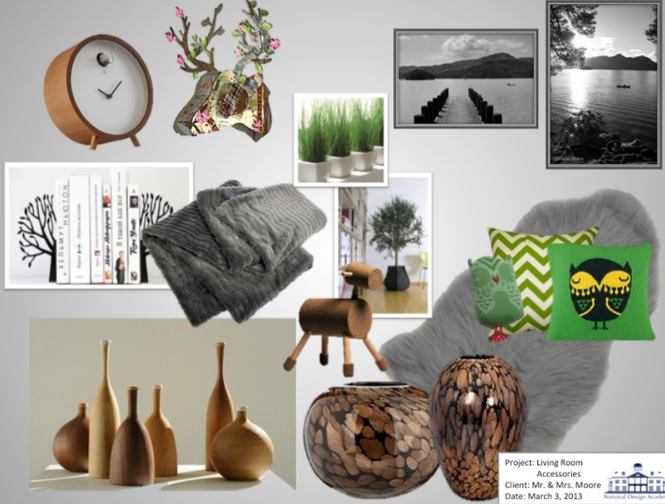
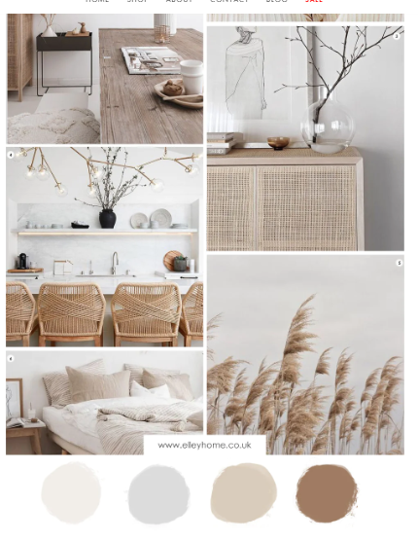
Task3: Create a Mood board around the theme 'Nature and the natural world' You need to include lots of different examples of textiles and fabrics that link to this theme. You should find images from the internet or magazines. You need about 20 images and you can use a single page in your book to display your images.
Example Mood-boards

Slide 4
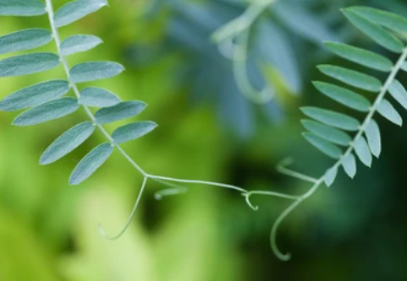
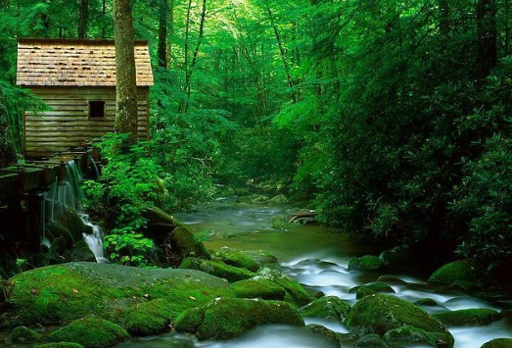
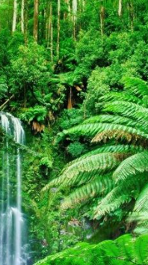
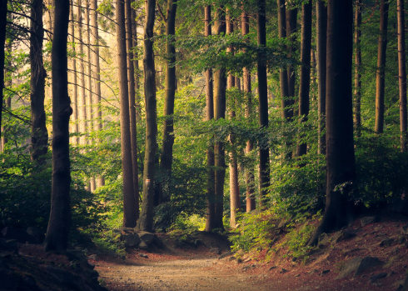
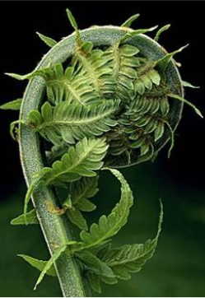
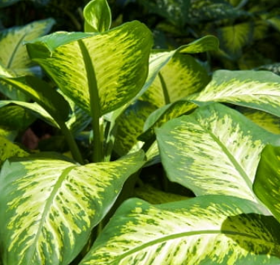
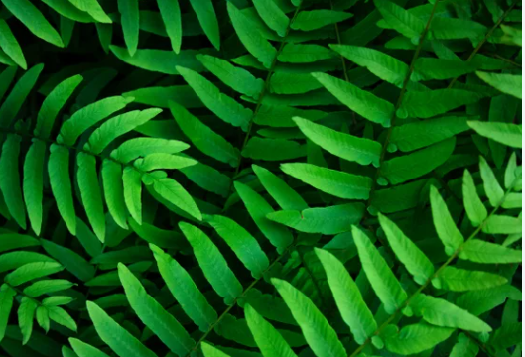
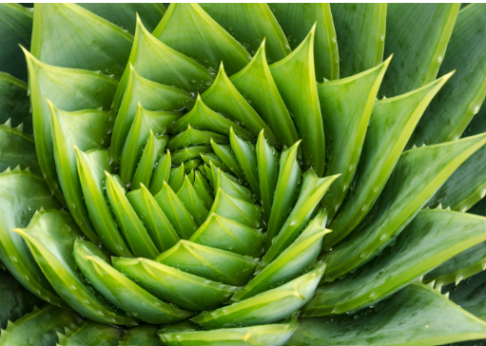
Task4: Photoshoot that links to the theme 'Nature and the natural world' You need to take between 15-20 photographs that link to nature. These can be close up shots of leaves, shells, flowers etc or on a big scale such as landscapes, trees, rivers, lakes, beaches etc. You should print your photos so that they fit on one or two pages (max) in your sketch book.

Slide 5
Task 5: Reasearch into a textile designer/ maker that links to the theme ' Nature and the natural world. Use the Research Guide and answer as many questions as you can about the designer you have chosen.
Some useful websites to find designers.
Art2day – Textiles section;
https://www.art2day.co.uk/textiles.html
TATE Modern:
https://www.tate.org.uk/art
V&A
https://www.vam.ac.uk/

Slide 6
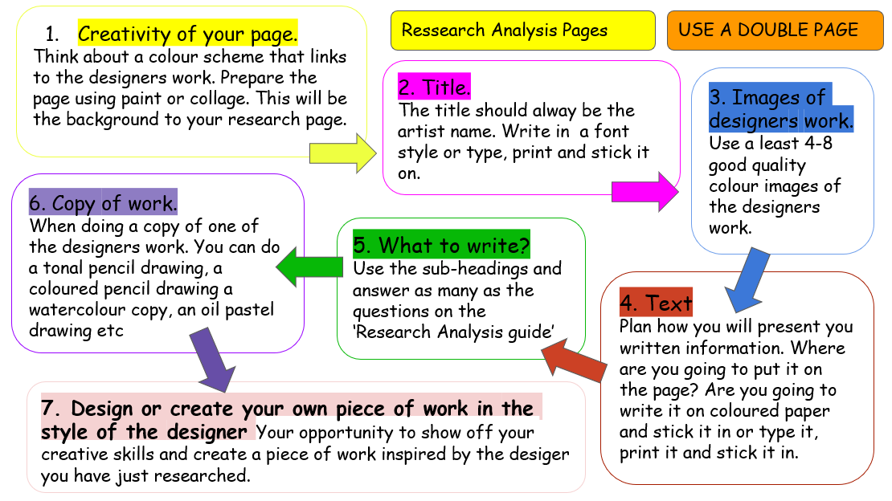
Research guide

Slide 7
Task 6: Design task. Taking inspiration from the designer you choose to research, and your mood-board create 3x different designs for textile products that link to our theme; 'Nature and the natural world.' These products could be an item of clothing, an accessory such as a hat, scarf, a home interior such as a cushion, lamp shade, curtains, a bag etc. Each design should be different, and you should add colour and annotations around your designs to describe your thought process.
Extension Task: Up cycle project​
Find a second-hand piece of fabric/textiles. It can be clothing, a tablecloth, an old curtain, tote bag etc. The task is to transform the piece of fabric into something else. You make could be a piece of clothing, a bag, hat, hair accessory, lamp shade piece of art/ wall hanging. Be as creative as you can.
Please bring all your work; sketch book and anything you make to our first lesson together in the new school year. I hope you have a wonderful summer and I am looking forward to seeing you in September. Mrs Bromley

